Slide 1
System Analysis And Design
Chapter One: Basic concepts in Information System development

Slide 2
Topics
System Analysis and design, System, Information systems, System thinking
Types of Information Systems
Participants in Information System Development
Roles and qualities of System Analyst
System development methodologies, Processes/Phase

Slide 3
Some basic definitions
Systems Analysis and Design: What is it?
  Systems analysis
    Process of studying an existing system to determine how it works and how it meets user needs
  Systems design
    Process of developing a plan for an improved system, based upon the results of the systems analysis

Slide 4
Cont…
System analysis and design is a step by step complex method where by computer based information systems that can perform basic business functions are developed and maintained.
It can also be defined as a standard set of activities, methods, best practices, deliverables, and automated tools that stakeholders use to develop and maintain information systems.
System AD is used to analyze, design and implement improvements in the functioning of businesses that can be accomplished through use of computerized information systems.

Slide 5
Cont…
It is based on two skills/knowledge
  Understanding of organizations objectives, structure and process (domain Knowledge)
  Knowledge of how to exploit information technology for advantage
Outcome of such SAD
  An application software (information systems) to improve users/employee efficiency
From the definition it is easy to understand that ‘System’, specifically ‘information system’ is a core concept.

Slide 6
System
A system is an interrelated set of components with an identifiable boundary, working together for some purpose.

Slide 7
Cont…
Characteristics of a system
  Components - either an irreducible part or an aggregate of parts (subsystem)
  Interrelated Components- the function of one is tied to the function of the other
  Boundary- the limits of the system with in which the system is contained, and that separates it from other systems.
  Purpose- The components work together to achieve some overall purpose: the system’s reason for existence
  Environment- Everything outside the system’s boundary
  Interfaces- the point at which the system meets its environment
  Input- What the system takes in from the environment to function
  Output- The result of the function of the system
  Constraints- limits to the system in terms of its capacity

Slide 8
Example
Viewing a car as a system helps us determine what the problem is and fix it by breaking the system down in to its components.
It is also important to consider the relationship one subsystem has with another in doing so.

Slide 9
Exercise
Identify something as a system
Identify and describe its characteristics ( the 9 characteristics discussed)

Slide 10
Other Important system concepts
  Decomposition- being able to break down a system into its components. It also helps to build different parts of the system at different times or by different individuals.
  Modularity- relatively uniform size components or chunks.

Slide 11
Cont…
  Coupling- the extent to which subsystems are dependent on each other. Subsystems should be as much independent from each other as possible.
  Cohesion- the extent to which a module or a subsystem performs a single function. When we have highly cohesive modules, each module accomplishes one and only one function. This makes the module reusable in future programs. Take a biological system as an example. It has highly cohesive modules. It is possible to transplant a heart or kidney.

Slide 12
Cont…
Systems thinking
  Is a mind set or way of viewing a world as a system. Actually, systems thinking is just one part of the skills a systems analyst requires
  it helps to see the big picture; it also helps to break problems down to their components to avoid complexity.
  It minimizes the effect a change in one module will have on another.
  It emphasizes on the relationship and the process that goes inside rather than constituent parts or just the sum of the parts. Accordingly
    “A system is bigger than the sum of its components”

Slide 13
Information system
Is an arrangement of people, data, processes, communication, and information technology that interact to capture, transmit, store, retrieve, manipulate and/or display information needed to support and improve day-to-day operations in a business as well as support the problem solving and decision making needs of management and other users.

Slide 14
Types of information systems
IS can be classified into various types based on their function:
  TPS
  MIS
  DSS
  ESS

Slide 15
Transaction Processing Systems (TPS)
  perform and record the daily routine transactions necessary to conduct business, such as sales order entry, hotel reservations, payroll, employee record keeping, and shipping.
  TPS are the foundation of other information systems

Slide 16
Management Information Systems (MIS)
  provide middle managers with reports on the organization’s current performance.
  the information is used to monitor and control the business and predict future performance
  MIS summarize and report on the company’s basic operations using data supplied by transaction processing systems.
  Most MIS use simple routines, such as summaries and comparisons, as opposed to sophisticated mathematical models or statistical techniques.

Slide 17
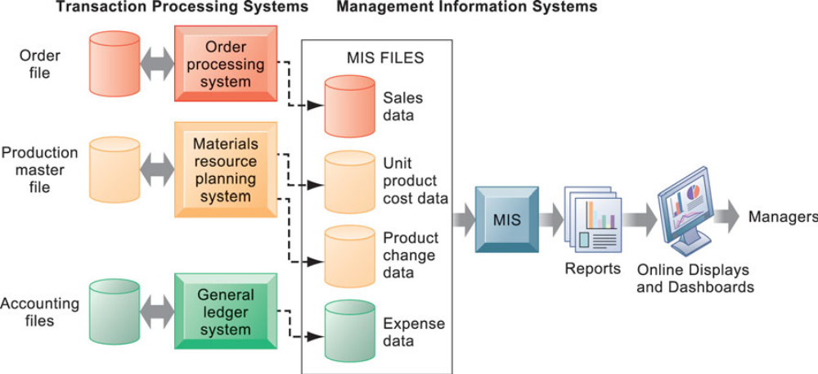

Slide 18
Decision Support System (DSS)
  support more non-routine decision making
  They try to answer questions such as these:
    What would be the impact on production schedules if we were to double sales in the month of December?
    What would happen to our return on investment if a factory schedule were delayed for six months?

Slide 19
Executive Support Systems (ESS)
  help senior management make strategic decisions
  In addition to drawing summarized information from internal MIS and DSS, ESS are designed to incorporate data about external events, such as new tax laws or competitors.

Slide 20
Cont…
Other Systems
  E-commerce Applications: Business to Customer, Business to Business, and Customer to Customer
  Enterprise Resource Planning (ERP) systems- integrate many ISs existing at various levels of management and used for various functions.

Slide 21
Participants in Information System Development
Usually system development is a team work and project based.
Who do you think are the stakeholders (participates) in IS design and development?
How do each of these stakeholders participate?

Slide 22
Cont…
System owners- pay for the system to be built and maintained.
  They own the system, set priorities for the system, and determine policies for its use. In some cases, system owners may also be system users.
System users- are the people who actually use the system to perform or support the work to be completed.
  System users define the business requirements and performance expectations for the system to be built.

Slide 23
Cont…
System analysts- facilitate the development of information systems and computer applications by bridging the communications gap that exists between non-technical system owners and users and technical system designers and builders.
System designers- are the technical specialists who design the system to meet users’ requirements. In many cases, system designers may also be system builders.

Slide 24
Cont…
System builders are the technical specialists who construct, test, and deliver the system into operation.
IT vendors and consultants who sell hardware, software and services to businesses for incorporation into their information systems.

Slide 25
Systems Analyst
Professional computer employee who performs information systems analysis and design
Change agent
  Overcome reluctance of users to change

Slide 26
Systems Analyst
Functions
Coordination
Schedules and system-related tasks
Personnel
  Manager
  Programmers
  Users
  Vendors of computer equipment

Slide 27
Systems Analyst
Functions
Communication
  Oral presentations
  Written documentation
Planning and design
  Plans and designs new system
  Involved from beginning of project to final implementation of the system

Slide 28
System Analyst
Necessary skills required
  Analytical skills
  Technical skills
  Management skills
  Interpersonal skills

Slide 29
Cont…
Analytical skills
  Systems thinking
  Organizational knowledge- how organizations work
    Example a payroll system developed for a Government Unit wouldn’t work for a private company
  Problem Identification- a problem is the difference between an existing situation and a desired situation. Being able to see the real problem from an organizational perspective.
  Problem analyzing and solving- finding out more about the problem, formulating alterative solutions, choosing the best alternative, devising a plan for its implementation.

Slide 30
Cont…
Technical skills- programming languages, operating systems, database systems, data communication systems, system development tools, web development languages, CASE tools

Slide 31
Cont…
Management skills
  Project management- prevent projects from coming in late or going over budget
  Resource management- delegating work, using resources effectively and efficiently
  Risk Management- identifying risk in an IS development process and minimizing it. For instance, use of standard or commonly used technology will be less risky.
  Change management- helps people make a smooth transition from one information system to another.

Slide 32
Cont…
Interpersonal skills
  Communication skills- interviewing, listening, written and oral presentations
  Working in a team,
  facilitating groups-guiding groups to work together
  Managing expectations- educate pessimists and temper the expectations of others.

Slide 33
System Development Approaches, Methodologies and Phases/Processes
Organizations use a standard set of steps, called a systems development methodology, to develop and support their information systems.
the most popular alternatives methodologies are:
  structured analysis
  object-oriented (O-O) analysis
  agile methodologies

Slide 34
Structured Analysis
Structured analysis is a traditional systems development technique represents the system in terms of data and the processes that act upon the data.
System development is organized into phases, with deliverables and milestones to measure progress.
The series of phases that the Structured Analysis uses is known as systems development life cycle (SDLC)

Slide 35
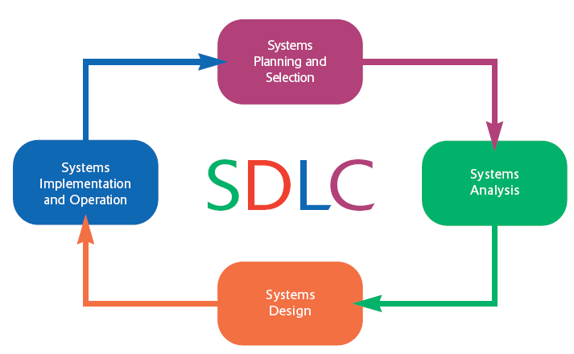

Slide 36
Phase 1: Systems Planning and Selection
The primary activities of this phase are:
  identifying the need for a new or enhanced system and
  Selection of projects that are perceived to meet the objectives of an organization
Information system needs of an organization may result from:
  Requests to deal with problems in current procedures
  The desire to perform additional tasks
  The realization that information technology could be used to capitalize on an existing opportunity

Slide 37
Once a project is selected a plan is designed that lays out important issues such as:
  Feasibility study
  Scope
  Schedule
The plan is finally presented to the management to proceed to the next phase.

Slide 38
Phase 2: Systems Analysis
During this phase, the analyst thoroughly studies the organization’s current procedures and the information systems used to perform different tasks.
The activities generally included in the analysis phase are:
  determining the requirements of the system
  Requirement structuring and elimination of redundencies
  generating alternative initial designs to match the requirements
The output of the analysis phase is a description of the alternative solution recommended by the analysis team

Slide 39
Phase 3: Systems Design
During systems design, analysts convert the description of the recommended alternative solution into logical and then physical system specifications.
Logical design is not tied to any specific hardware and systems software platform.
During physical design decision is made regarding:
  programming language
  database systems
  hardware platform
  operating system, and
  network environment the system will run under.
The final product of the design phase is the physical system specifications

Slide 40
Phase 4: Systems Implementation and Operation
During systems implementation and operation, you turn system specifications into a working system that is tested and then put into use.
Implementation includes coding, testing, and installation.
During operation, programmers make the changes that users ask for and modify the system to reflect changing business conditions. This is known as Maintenance.

Slide 41
Object-Oriented Analysis
Object oriented analysis combines data and the processes that act on the data into things called objects.
Systems analysts use O-O to model real-world business processes and operations.
It is a methodology that programmers can easily translate the model into codes using object-oriented programming languages.

Slide 42
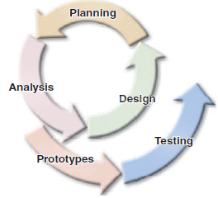
Cont’d..
The phases in O-O analysis tend to be more interactive.
In this model, planning, analysis, and design tasks interact continuously.

Slide 43
Agile Methodologies
Agile Methodologies a family of development methodologies characterized by
  short iterative cycles and extensive testing
  active involvement of users for establishing, prioritizing, and verifying requirements and
  a focus on small teams of talented, experienced programmers.

Slide 44
Other Development Methodologies
Rapid application development (RAD) is a Systems development methodology created to radically decrease the time needed to design and implement information systems participatory design (PD)
Rational Unified Process (RUP) is an iterative software development process framework created by the Rational Software Corporation, a division of IBM
Microsoft Solutions Framework (MSF) is an approach by Microsoft.

Slide 45
Systems Development Tools and Techniques
To plan, design, and implement information systems, analysts need to know how to use techniques such as:
  Modelling
  Prototyping
  CASE (Computer-aided Software Engineering) tools
  Joint Application Design (JAD)

Slide 46
Modelling
Modelling produces a graphical representation of a concept or process.
Systems analyst can describe and simplify an information system by using different kinds of models.
ER, DFD, Use Case, Class Diagram, and some examples of models.
Multipurpose charting tools such as Microsoft Visio are used to create various types of models.

Slide 47
Prototyping
A prototype is an early working version of an information system.
A prototype can serve either as:
  an initial model that is used as a benchmark to evaluate the finished system, or
  the prototype itself can develop into the final version of the system.
Prototypes are efficient tools of collecting requirement in a more concrete way.

Slide 48
Computer-Aided Software Engineering (CASE) Tools
Computer-aided software engineering (CASE) refers to automated software tools used by systems analysts to develop information systems.
The general types of CASE tools include:
  Diagramming tools
  Computer display and report generators
  Documentation generators
  Code generators

Slide 49
Joint Application Design
joint application design (JAD) is a process the purpose of which is to structure the requirements determination phase of analysis and the reviews that occur as part of the design
Users, managers, and systems developers are brought together for a series of intensive structured meetings run by a JAD session leader

Slide 50
Systems Development Guidelines
Develop a Plan
  Prepare an overall project plan and stick to it. Complete the tasks in a logical sequence. Develop a clear set of ground rules and be sure that everyone on the team understands them clearly.
Involve Users and Listen Carefully to Them
  Ensure that users are involved in the development process, especially when identifying and modelling system requirements.
  When you interact with users, listen closely to what they are saying.

Slide 51
Cont’d..
Use Project Management Tools and Techniques
  Try to keep the project on track and avoid surprises.
  Create a reasonable number of checkpoints — too many can be burdensome, but too few will not provide adequate control.

Slide 52
Cont’d..
Develop Accurate Cost and Benefit Information
  Managers need to know the cost of developing and operating a system, and the value of the benefits it will provide.
  Accurate realistic cost and benefit estimates should be provided.

Slide 53
Cont’d..
Remain Flexible
  Be flexible within the framework of your plan.
  Systems development is a dynamic process, and overlap often exists among tasks. The ability to react quickly is especially important when you are working on a system that must be developed rapidly.

